Slide 1
Final Presentation
The Kingdom of Eswatini - National MPI
By:
Anh Thu
12th August 2022

Slide 2
CONTENT
Overview
Dimensions and Indicators
Robustness Analysis
Poverty Cut-off
National Multidimensional Poverty Measurement
Contribution
Disaggregation
Conclusion

Slide 3
1. OVERVIEW
This MPI is designed to help for achieving national poverty reduction in all forms and improve policy planning by evidence.
Mainly focus on three dimensions Health, Schooling & Standard of living of the people of Eswatini.
Unit of identification: household
Unit of analysis: individual
Notes:
Improved Access to Quality, Relevant & Inclusive
Education & Lifelong Learning Opportunities
3. Reduced Poverty Rates in All its Forms
4. The Youth and Other Vulnerable Groups Empowered
with Adequate Skills and Opportunities
5. Improved & Coordinated R&D & Innovation Systems
for Evidence-Based Planning & Policy Formulation

Slide 4
2. FINAL LIST OF INDICATORS & CUTOFFS & WEIGHTS
Dimension | Indicator | Cutoff | Weight
Health | Nutrition | Deprived if any child in the HH is underweight or stunted | 1/12
 | Vaccination | Deprived if there is child under 3 y.o has not had at least 14 doses vaccines (over 16 doses in total) | 1/12
 | Under 5 y.o Mortality | Deprived if there is any child under 5 y/o in the HH died | 1/12
 | Using iodized salt | Deprived if the HH does not use iodized salt | 1/12
Living Standard | Access to clean water | Deprived if the HH does not have safe water source | 1/12
 | Access to clean sanitation | Deprived if the HH does not have clean sanitation | 1/12
 | Access to electricity | Deprived if the HH does not have electricity | 1/12
 | Assets | Deprived if the HH owns less than 5 basic assets and does not own any vehicle ( car/truck or motorbike) | 1/12
 | Housing | Highly correlated with electricity and assets
Education | Years of Schooling | Deprived if highest education level of the HH is only secondary education or below | 1/6
 | Lagging in School | Deprived if any child in the HH lagged 2 years or more in schooling | 1/6
Employment | No data available
Notes:
Important elements in this strategy are appropriate education and training (including a reorientation away from the presently academic orientation to technical and vocational
Raise the immunisation to fully vaccinated

Slide 5
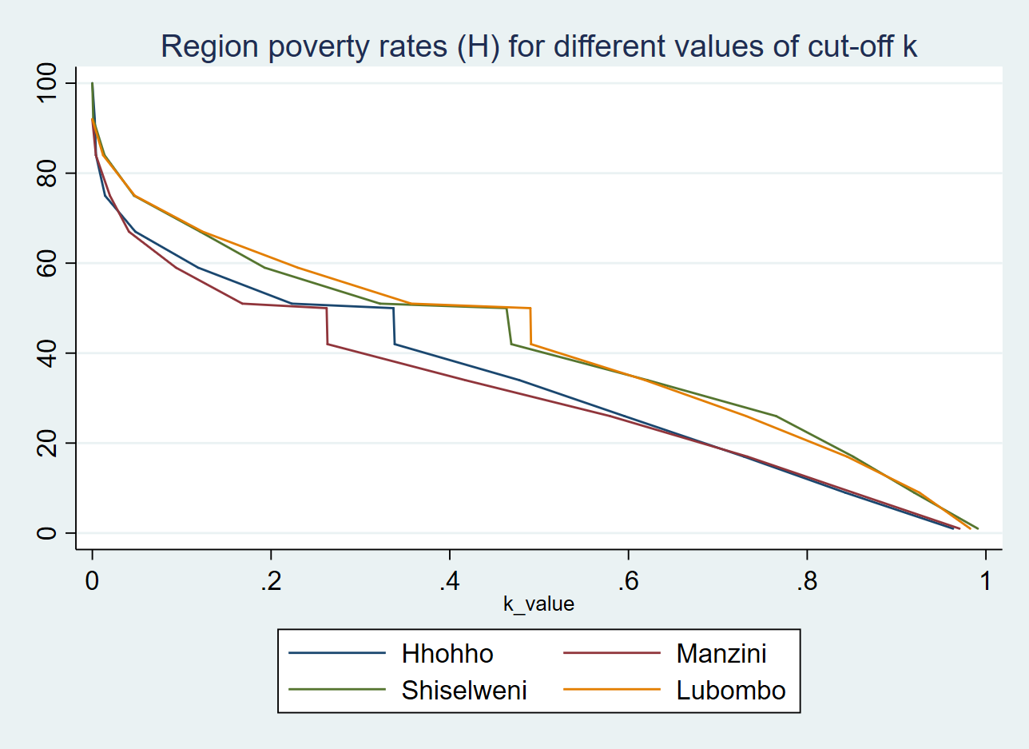
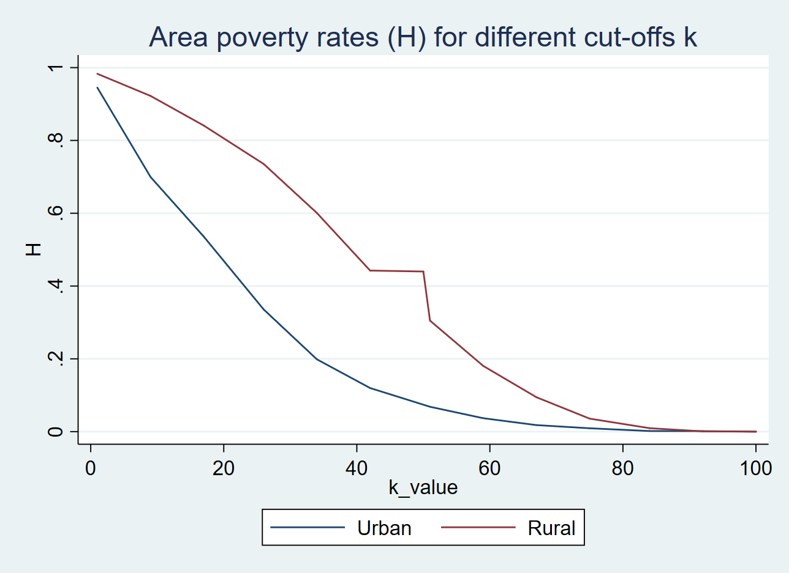
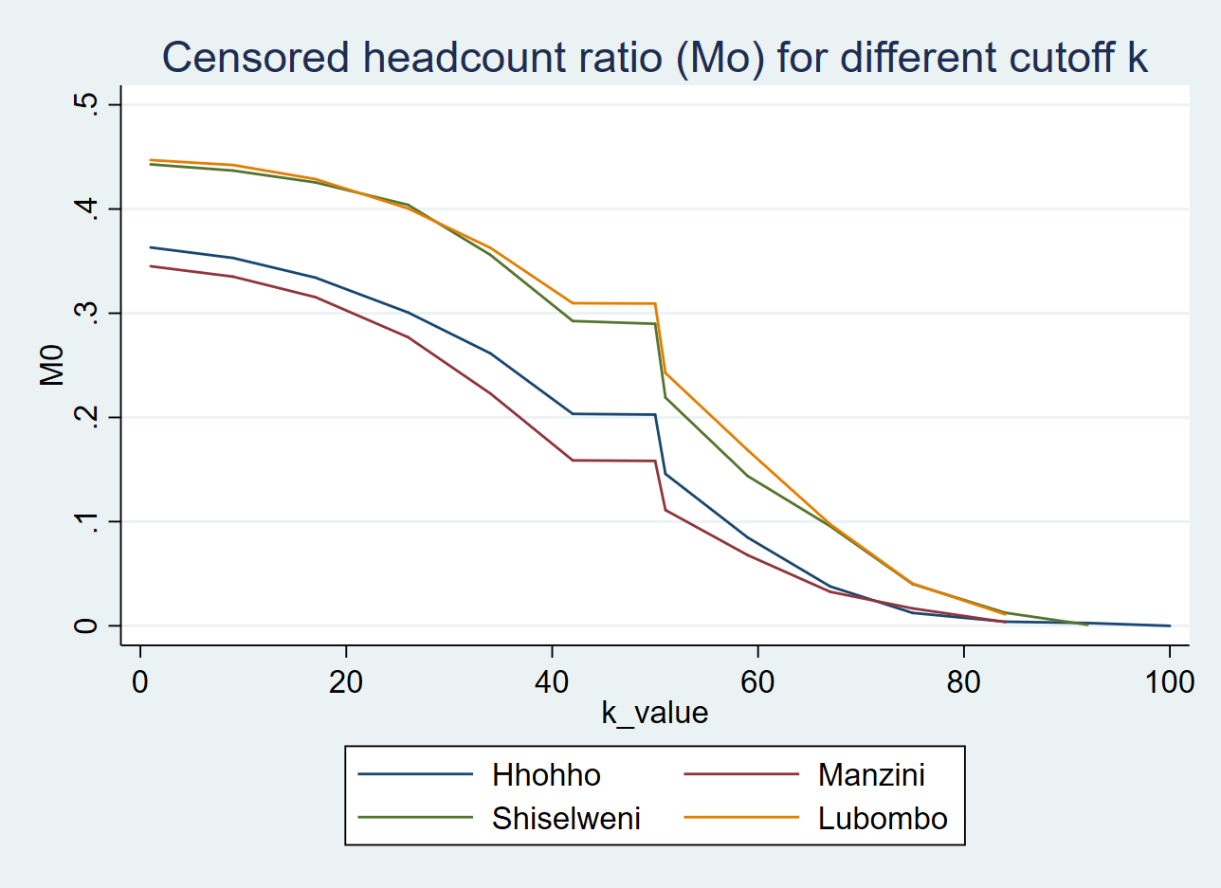
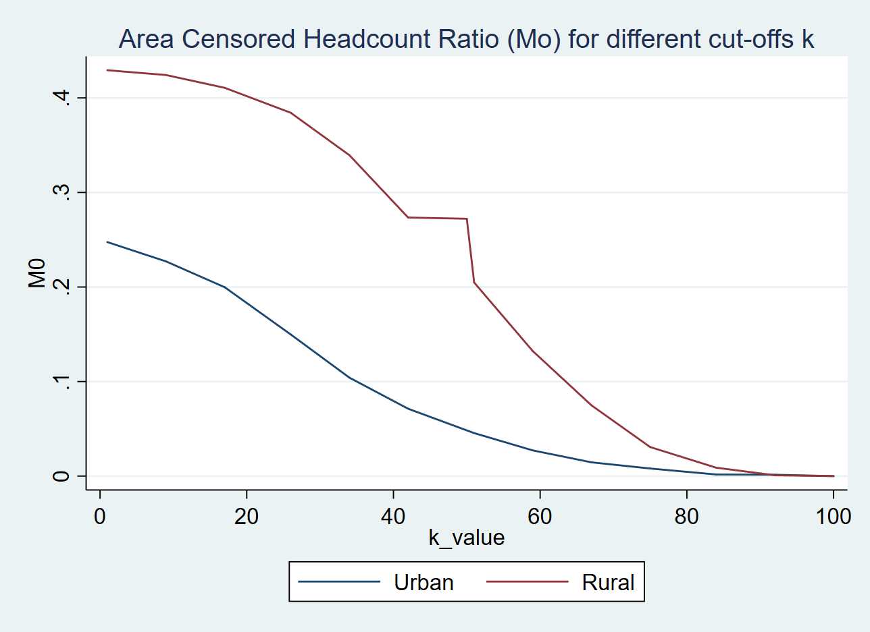
3. ROBUSTNESS ANALYSIS

Slide 6
3. ROBUSTNESS ANALYSIS
Region pair |  | k = 30 |  |  | k = 40 |  |  | k = 50
 |  | MPI | MPI | p_value | MPI | MPI | p_value | MPI | MPI | p_value
Hhohho | Manzini | 0.285 | 0.249 | 0.068 | 0.244 | 0.192 | 0.013 | 0.187 | 0.133 | 0.005
Hhohho | Shiwelni | 0.285 | 0.408 | 0.00 | 0.244 | 0.362 | 0.00 | 0.187 | 0.291 | 0.00
Hhohho | Lumbobo | 0.285 | 0.371 | 0.001 | 0.244 | 0.337 | 0.001 | 0.187 | 0.284 | 0.00
Manzini | Shiwelni | 0.249 | 0.408 | 0.00 | 0.192 | 0.362 | 0.00 | 0.133 | 0.291 | 0.00
Manzini | Lumbobo | 0.249 | 0.371 | 0.00 | 0.192 | 0.337 | 0.00 | 0.133 | 0.284 | 0.00
Shiwelni | Lumbobo | 0.408 | 0.371 | 0.137 | 0.362 | 0.337 | 0.364 | 0.291 | 0.284 | 0.789
Urban | Rural | 0.140 | 0.372 | 0.00 | 0.090 | 0.326 | 0.00 | 0.058 | 0.258 | 0.00

Slide 7
4. POVERTY CUTOFF
Our Consideration:
Overall poverty rate 58.9 percent, with 20 percent under extreme poverty line (monetary)
Net Available Financing from Domestic is still low ( <30% total proj)
Cut-off: k = 50%
Notes:
private sector active participation and development towards the creation of a diversified and resilient economy for sustained higher growth and socioeconomic development
Strategy 3 - Rebalance expenditures and reduce size of wage-bill

Slide 8
5. NATIONAL MULTIDIMENSIONAL POVERTY MEASUREMENT
Ratio | Mean | Standard error | Lower bound | Upper bound
M_0 | 0.24 | 0.01 | 0.22 | 0.26
H | 0.39 | 0.02 | 0.36 | 0.42
A | 0.62 | 0.005 | 0.61 | 0.63
Notes:
Insert a table showing M0, H and A at the national level
Interpret the results and outline its relevance for policy

Slide 9
NATIONAL CENSORED HEADCOUNT RATIOS AT DIFFERENT CUT-OFF

Slide 10
UNCENSORED VS CENSORED HEADCOUNT RATIOS BY INDICATORS

Slide 11
CENSORED HEADCOUNT RATIOS BY REGION/AREA
Subgroup | Sample Size | Pop Share (%) | MPI | Poverty Rate | Intensity
National | 16023 | 100 | 0.24 | 0.39 | 0.62
Hhohho | 5134 | 25.35 | 0.19 | 0.31 | 0.6
Manzini | 5031 | 36.39 | 0.13 | 0.22 | 0.6
Shiselweni | 4839 | 17.87 | 0.29 | 0.47 | 0.63
Lubombo | 4149 | 20.37 | 0.28 | 0.45 | 0.62
Urban | 3437 | 25.98 | 0.06 | 0.1 | 0.58
Rural | 15716 | 74.01 | 0.26 | 0.42 | 0.62
Notes:
Insert a graph showing the censored headcount ratios (including confidence intervals)
Provide a short explanations of the results and recommendations for policymakers

Slide 12
6. CONTRIBUTIONS
Dimension | Indicator | Contribution on Nation MPI
 |  | Relative (%) | Absolute
Health | Nutrition | 4.93 | 0.012
 | Vaccination | 7.27 | 0.018
 | Under 5 y.o mortality | 3.63 | 0.009
 | Using Iodised Salt | 8.61 | 0.021
Living Standard | Access to clean water | 6.56 | 0.16
 | Access to clean sanitation | 4.92 | 0.12
 | Access to Electricity | 9.31 | 0.023
 | Household Assets | 8.03 | 0.020
Education | Years of Schooling | 22.62 | 0.055
 | Lagging in School | 24.12 | 0.059
Total |  | 100 | 0.244
Notes:
Insert a graph showing the indicator contributions
Provide a short explanations of the results and recommendations for policymakers

Slide 13
7. DISAGGREGATION
Indicator/Subgroup | Hhohho | Manzini | Shiselweni | Lubombo | Urban | Rural
Nutrition | 1 | 2 | 1 | 1 | 2 | 3
Vaccination | 2 | 3 | 1 | 1 | 3 | 5
Under 5 y.o mortality | 1 | 1 | 1 | 1 | 2 | 3
Using Iodised Salt | 2 | 3 | 2 | 2 | 3 | 6
Clean water | 2 | 2 | 1 | 1 | 1 | 5
Sanitation | 2 | 1 | 1 | 1 | 1 | 4
Electricity | 3 | 3 | 2 | 2 | 2 | 7
Household Assets | 2 | 3 | 2 | 2 | 2 | 6
Years of Schooling | 6 | 9 | 4 | 5 | 7 | 18
Lagging in School | 6 | 8 | 4 | 4 | 4 | 16
TOTAL | 25% | 36% | 18% | 20% | 26% | 74%
Notes:
Insert a table and graph showing key results for your subnational or other chosen disaggregation (include population shares)
Provide a short explanations of the results and recommendations for policymakers

Slide 14
8. CONCLUSIONS
At poverty cut-off 50%, multidimensional poverty of Eswatini is 24.4%, we focus on the severely poor people. Shiwelni and Lumbobo are the poorest region with MPI 29% and 28%, respectively. Besides, rural areas also lagged far behind from urban region.
Improvement in education (access to schooling) and living standard (access to electricity and assets ownership) is recommended.
Notes:
Re-prioritise poverty reduction as an area of
national focus
2. Improve targeting of social assistance programmes
3. Promote a more equitable pattern of growth
coupled with investment in the people
4. Invest in rural infrastructure and promote
decentralisation

